Slide 1

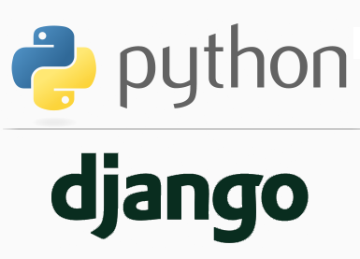
FULL STACK WEB DEVELOPMENT WITH DJANGO
Lecture 9

Slide 2

Today’s Agenda
Developing Our Django App
Introduction To Templates
Benefit Of Templates
Configuring Templates
Steps Needed For Template Based App

Slide 3
Introduction To Templates
In all our previous examples, we set the HTML code in our views.py file of the Django App.
def homePageView(request):
return HttpResponse("<h1>Welcome To Sharma Computer Academy!</h1>")
Although this technique was convenient for the purpose of learning how views work, but it’s not a good idea to hard-code HTML directly into your views.

Slide 4
Introduction To Templates
The reasons are multiple:
Any change to the design of the page requires a change to the Python code.
The design of a site tends to change far more frequently than the underlying Python code, so it would be convenient if the design could change without modifying the Python code.
Writing Python code and designing HTML are two different disciplines, and most professional web development environments split these responsibilities between separate people.

Slide 5
Introduction To Templates
Web Designers (HTML/CSS coders) shouldn’t be required to edit Python code to get their job done.
It’s most efficient if developers can work on Python code and designers can work on HTML and CSS at the same time, rather than one person waiting for the other to finish editing a single file that contains both Python and HTML.

Slide 6
Introduction To Templates
For these reasons, it’s much cleaner and more maintainable to separate the design of the page from the Python code itself.
And this is achieved using Django’s template system

Slide 7
Introduction To Templates
Django template system makes it possible to separate Python and HTML.
The Python code goes in views and HTML code goes in templates.
To link the two, Django relies on the render() function and the Django Template language.

Slide 8
Introduction To Templates
The template will contain the static parts of an html page (parts that are always the same)
Then there are template tags, which have their own special syntax.
This syntax allows you to inject dynamic content that your Django App’s views will produce, effecting the final HTML

Slide 9
Steps Needed For Templating
To create and run a Django app using Templates, we need to follow 11 steps:
Activating Django Environment in VS Code
Creating a Django Project in VS Code
Creating the app
Activating the app
Create the templates directory structure.
Configuring settings.py for templates
Create the HTML file inside the templates directory
Creating the view to render the template
Configuring the View in Url
Running the server
Opening the page in browser

Slide 10
Steps Needed For Templating
Amongst these 11 steps , step-1, step-2,step-3, step-4, step 9,step-10 and step-11 will remain as before.
So we will focus only on steps 5,6 ,7 and 8.

Slide 11
Template Directory Structure
There are two ways to organize our template structure in our Django project:
Keeping template files of all apps in one folder
Creating separate folders for every app

Slide 12
Template Directory Structure
This is the simplest way of creating and storing template files for all the apps of a Django project
In this approach we go to the Django project folder , which is the outer folder and in that folder we create another folder called templates
Within the templates folder we create the .html file

Slide 13
Template Directory Structure
├── example_project
├── example_project
├── __init__.py
├── settings.py
├── urls.py
└── wsgi.py
└── pages
├── __init__.py
├── admin.py
├── apps.py
├── models.py
├── tests.py
└── views.py
├── templates
├── home.html
└── manage.py

Slide 14
Configuring Settings File
However when we do this , we must inform Django about this templates directory.
This is done as follows:
Open the file settings.py
Create a variable for storing path to the templates folder
Update the 'DIRS' config under TEMPLATES as follows:
# settings.py
TEMPLATES_DIR=os.path.join(BASE_DIR, 'templates')
TEMPLATES = [
{ ...
'DIRS': [TEMPLATES_DIR],
... },
]

Slide 15
Code Explained
TEMPLATES_DIR=os.path.join(BASE_DIR, 'templates')
TEMPLATES = [
{ ...
'DIRS': [TEMPLATES_DIR],
... },
]
TEMPLATES is a list which contains information about the templates used by this project.
Within the TEMPLATES list , we have a dictionary with a key called DIR.
The value for this key should be the name and path of the templates directory.

Slide 16
Code Explained
TEMPLATES_DIR=os.path.join(BASE_DIR, 'templates')
TEMPLATES = [
{ ...
'DIRS': [TEMPLATES_DIR],
... },
]
BASE_DIR is a variable pre-initialized with the path to the project’s directory. We can view it’s definition at the top of settings.py file as follows:
BASE_DIR = os.path.dirname(os.path.dirname(os.path.abspath(__file__)))
join() is a function in os.path module which accepts 2 arguments representing the directory path and file name and returns a string containing the complete path

Slide 17
Code Explained
TEMPLATES_DIR=os.path.join(BASE_DIR, 'templates')
TEMPLATES = [
{ ...
'DIRS': [TEMPLATES_DIR],
... },
]
TEMPLATES_DIR is a programmer defined variable which contains the final path to the templates directory.
Its not necessary that this variable should have the name TEMPLATES_DIR , we can give any name to it.

Slide 18
Step 1-Activating Django Environment In VS Code
Before writing our template based app , we must as usual activate virtual environment for our project folder in VS Code.
To do this , follow the steps given below:
Launch VS Code and open the project folder myvsdjangoproject
In VS Code, open the Command Palette (View > Command Palette or (Ctrl+Shift+P)).
Then select the Python: Select Interpreter command:

Slide 19
Step 1-Activating Django Environment In VS Code
The command presents a list of available interpreters that VS Code can locate automatically.
Select the virtual environment in our project folder.
Run Terminal: New Terminal (Ctrl+Shift+`) from the Command Palette, which creates a terminal and automatically activates the virtual environment by running its activation script.

Slide 20
Step 2-Creating Django Project In VS Code
Now the next task is to create the Django project, which is done by typing the following command at VS Code terminal in the myvsdjangoproject directory:
django-admin startproject demoproject5
Doing this will generate the same file/folder structure as we saw before

Slide 21
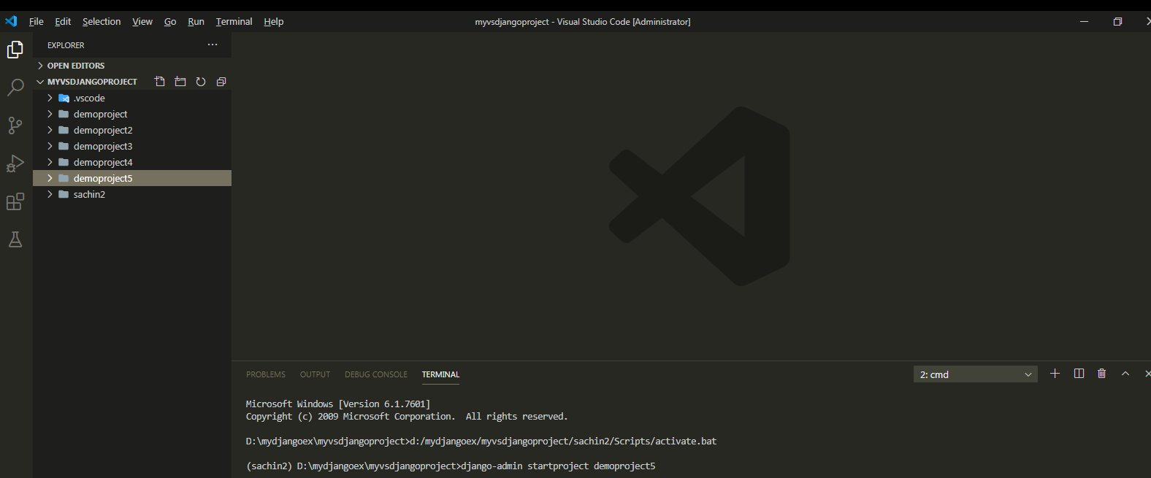
Step 2-Creating Django Project In VS Code

Slide 22
Step 3- Creating The App
As before we must create an app inside our demoproject5 folder by using the following command :
django-admin startapp appname
where appname is the name of our Django app

Slide 23
Step 3- Creating The App
In our case , we will create 2 apps called courses and trainers.
Go to the outer demoproject5 folder and type the following two commands
django-admin startapp courses
django-admin startapp trainers
When we execute the above command Django will create appropriate file/folder structure for our app

Slide 24
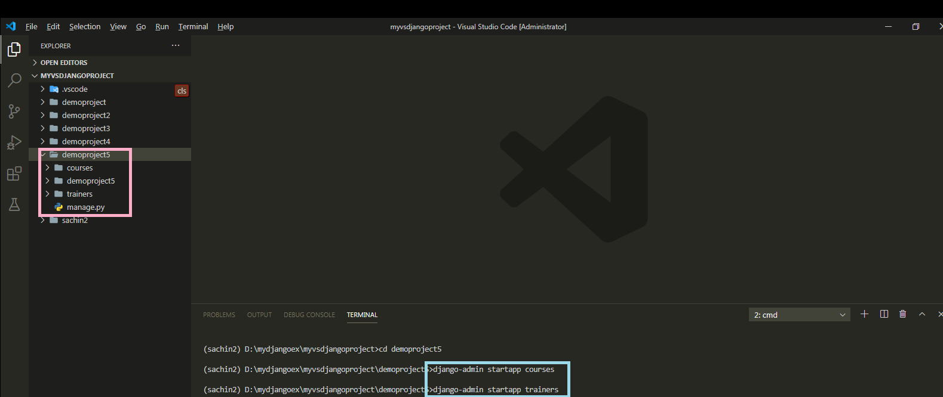
Step 3- Creating The App

Slide 25
Step 4: Activating The App
As done before , after creating the app we must let Django know about it by making the entry in the INSTALLED_APPS list of the settings.py file of the default app given by Django.

Slide 26
Step 4: Activating The App
Open the settings.py file in the demoproject5 app of our demoproject5 folder and make the entry shown in green color in the INSTALLED_APPS list
Code:
INSTALLED_APPS = [
'django.contrib.admin',
'django.contrib.auth',
'django.contrib.contenttypes',
'django.contrib.sessions',
'django.contrib.messages',
'django.contrib.staticfiles',
‘courses',
‘trainers’
]

Slide 27
Step 5: Creating The templates Directory
The next step is to create the templates folder
Now since we are using the single folder approach of using templates , so we must follow the below mentioned steps as discussed before:
Go to the main project folder called demoproject5 and create a folder there called templates
This can simply be done by choosing create folder option of VS Code
Make sure the name is exactly templates

Slide 28
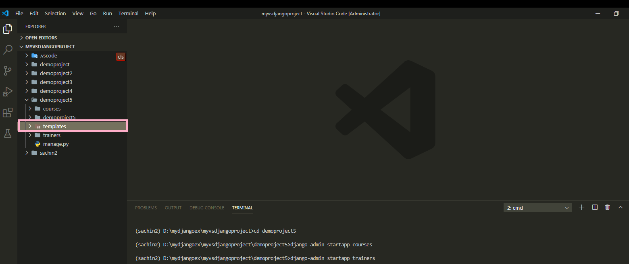
Step 5: Creating The templates Directory

Slide 29
Step 6: Updating The settings.py File
As discussed previously , after creating templates folder we must inform Django about it.
To do this we must follow the following steps:
Open the settings.py file in the demoproject5 app
Write the code shown in green color
TEMPLATES_DIR=os.path.join(BASE_DIR, 'templates')
TEMPLATES = [
{ ...
'DIRS': [TEMPLATES_DIR],
... },
]

Slide 30
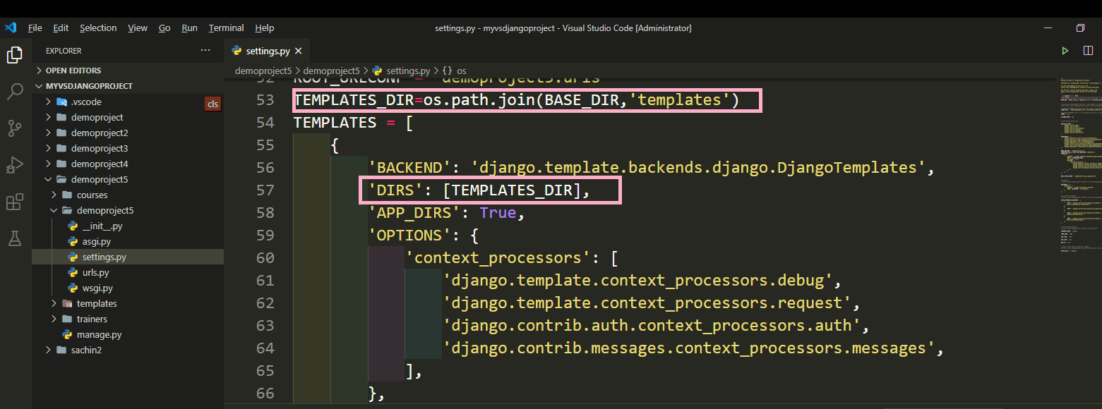
Step 6: Updating The settings.py File

Slide 31
Step 7: Creating The HTML Files
Once we’ve done creating templates folder structure then we can create an html files needed by our apps.
We will start by creating 2 html files each for courses and trainers apps called:
frontendcourses.html
backendcourses.html
frontendtrainers.html
backendtrainers.html

Slide 32
Step 7: Creating The HTML Files
Initially we will only keep HTML data in these files but later on we will insert template tags (a.k.a Django Template Variable).
These template variables will allow us to inject content into the HTML directly from Django views!

Slide 33
Step 7: Creating The HTML File
#frontendcourses.html
<!DOCTYPE html>
<html lang="en">
<head>
<meta charset="UTF-8">
<meta name="viewport" content="width=device-width, initial-scale=1.0">
<title>Front End Courses</title>
</head>
<body>
<h2> Welcome To Sharma Computer Academy</h2>
<h3>Our Front-End Courses</h3>
<ul>
<li>HTML 5</li>
<li>CSS 3</li>
<li>Modern Java Script</li>
<li>BootStrap</li>
<li>JQuery</li>
<li>Ajax</li>
</ul>
</body>
</html>

Slide 34
Step 7: Creating The HTML File
#backendcourses.html
<!DOCTYPE html>
<html lang="en">
<head>
<meta charset="UTF-8">
<meta name="viewport" content="width=device-width, initial-scale=1.0">
<title>Back End Courses</title>
</head>
<body>
<h2> Welcome To Sharma Computer Academy</h2>
<h3>Our Back-End Courses</h3>
<ul>
<li>Django</li>
<li>JEE</li>
<li>Spring Core</li>
<li>Spring Boot</li>
<li>ASP.Net</li>
<li>Node JS</li>
</ul>
</body>
</html>

Slide 35
Step 7: Creating The HTML File
#frontendtrainers.html
<!DOCTYPE html>
<html lang="en">
<head>
<meta charset="UTF-8">
<meta name="viewport" content="width=device-width, initial-scale=1.0">
<title>Front End Trainers</title>
</head>
<body>
<h2> Welcome To Sharma Computer Academy</h2>
<h3>Our Front-End Trainers</h3>
<ul>
<li>Mr. Paramjeet Singh</li>
<li>Ms. Seema Sharma</li>
<li>Mr. Sanjeev Sharma</li>
<li>Mr. Sachin Kapoor</li>
</ul>
</body>
</html>

Slide 36
Step 7: Creating The HTML File
#backendtrainers.html
<!DOCTYPE html>
<html lang="en">
<head>
<meta charset="UTF-8">
<meta name="viewport" content="width=device-width, initial-scale=1.0">
<title>Back End Trainers</title>
</head>
<body>
<h2> Welcome To Sharma Computer Academy</h2>
<h3>Our Back-End Trainers</h3>
<ul>
<li>Mr. Naman Garg</li>
<li>Mr. Aftaab</li>
<li>Mr. Arif</li>
<li>Mr. Sachin Kapoor</li>
</ul>
</body>
</html>

Slide 37
Step 8:Creating The View
Now we have the template in place, so we need to update our views.py.
Previously we simply returned some HTML text from our views.py file, but when we wish to use a template, we have to call a function called render()

Slide 38
Step 8:Creating The View
The function render() is available in the module django.shortcuts and has the following syntax:
Syntax:
render(request,template_file_name,context)
The render() function accepts the following parameters:
The original request object, which is an HttpRequest.
Name of the HTML template file
An optional context variable, which is a Python dictionary, containing the data to insert into the template file
We'll talk about context variable in the future lectures

Slide 39
Step 8:Creating The View
Following is the code for views.py, of our courses app where we are simply passing the original request object and the name of our site template.
courses/views.py
from django.shortcuts import render
def showFrontEndCourses(request):
return render(request,'frontendcourses.html')
def showBackEndCourses(request):
return render(request,'backendcourses.html')

Slide 40
Step 8:Creating The View
Similarly following is the code for views.py, of our trainers app
trainers/views.py
from django.shortcuts import render
def showFrontEndTrainers(request):
return render(request,'frontendtrainers.html')
def showBackEndTrainers(request):
return render(request,'backendtrainers.html')

Slide 41
Step 9:Configuring The View In Url
After creating and updating the views.py as shown in the previous slide we need to tell Django this is the view we want displayed when someone navigates to a particular url
As usual we do this by configuring our URLs at 2 places:
Inside the courses and trainers app’s urls.py file
Inside the site’s main urls.py

Slide 42
Step 9:Configuring The View In Url
In the VS Code create a new file called urls.py in both , courses and trainers apps folder , and write the following code in it.
Code (courses/urls.py):
from django.urls import path
from . import views
urlpatterns = [
path('showfe/', views.showFrontEndCourses),
path('showbe/', views.showBackEndCourses),
]

Slide 43
Step 9:Configuring The View In Url
Code (trainers/urls.py):
from django.urls import path
from . import views
urlpatterns = [
path('showfe/', views.showFrontEndTrainers),
path('showbe/', views.showBackEndTrianers),
]

Slide 44
Step 9:Configuring The Sites Main urls.py File
As we know whenever a request arrives it first hits the main urls.py file , that is , the file urls.py in the directory demoproject5.
So we must configure this file also so that it simply redirects the request to our courses and trainer app’s urls.py file whenever a matching request arrives

Slide 45
Step 9:Configuring The Sites Main urls.py File
In the VS Code open the file called urls.py in the demoproject5 folder and update the code in it as shown below in green.
Code (demoproject5/urls.py):
from django.contrib import admin
from django.urls import path,include
urlpatterns = [
path('admin/', admin.site.urls),
path('courses/',include('courses.urls')),
path('trainers/',include('trainers.urls')),
]

Slide 46
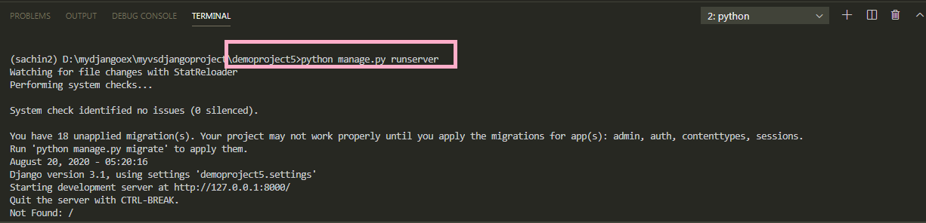
Step 10:Running The Server
To run the app, go to the project folder demoproject5 by using cd command and type the runserver command in VS Code terminal
cd demoproject5
python manage.py runserver.
The server runs on the default port 8000, and we’ll see output like the following output in the terminal window:

Slide 47
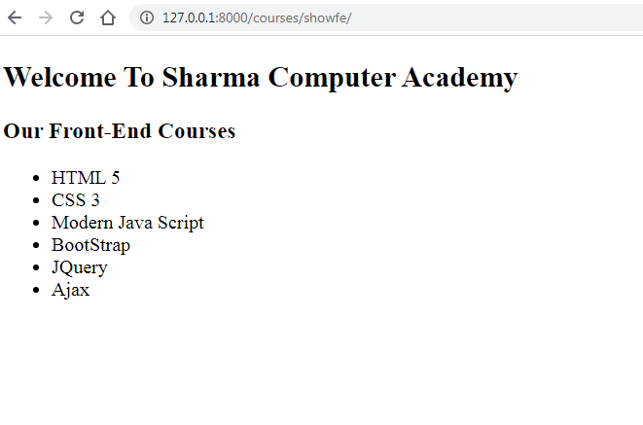
Step 11: Opening The Page
Ctrl+click the http://127.0.0.1:8000/ URL in the terminal output window to
open default browser and type the url http://127.0.0.1:8000/courses/showfe

Slide 48
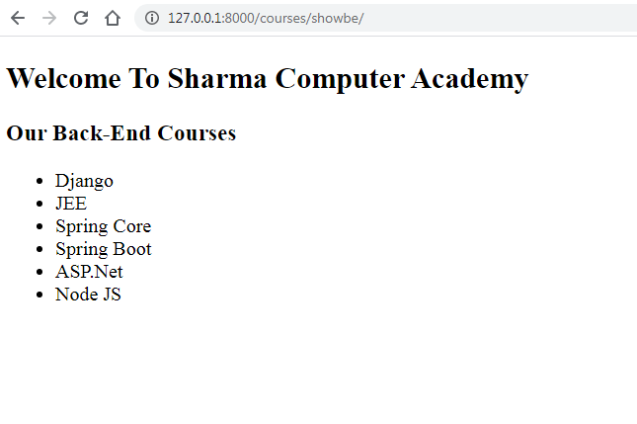
Step 11: Opening The Page
Type the url http://127.0.0.1:8000/courses/showbe

Slide 49
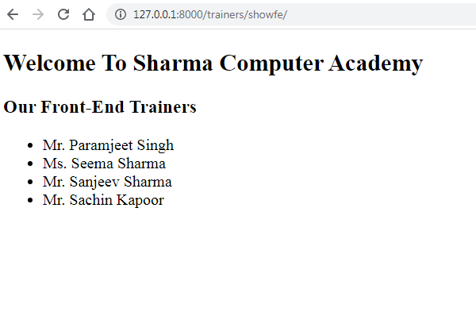
Step 11: Opening The Page
Type the url http://127.0.0.1:8000/trainers/showfe

Slide 50
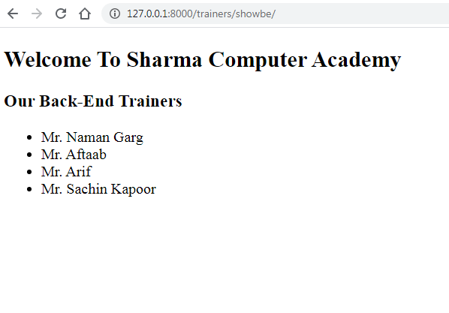
Step 11: Opening The Page
Type the url http://127.0.0.1:8000/trainers/showbe

Slide 51
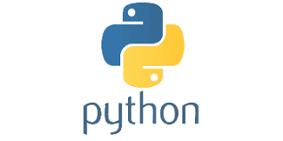
Exercise
Write a Django App using templates which displays the message Help Page
Do the following:
Create a templates directory and connect it to the settings.py file
Create a new view called help and use url mapping to render it for any page with the extension /help
Return the message “Help Page” from your template html file.

